Slide 1


LIBOR

Slide 2

LIBOR
LIBOR is an acronym for London Inter Bank Offered Rate.

Slide 3

LIBOR
LIBOR serves as a benchmark that gives an indication of the rate at which banks can borrow from London interbank market for a given period of time.
The interbank borrowing is undertaken by financial institutions either to make profits or to cover short-term liquidity shortfalls.

Slide 4
LIBOR
Basically, it represents the cost of funds — an average of what banks believe they would have to pay to borrow a “reasonable” amount for a specified short period.

Slide 5

LIBOR is compiled by the British Bankers’ Association (BBA) in conjunction with Reuters and are released for 15 different time periods and for 10 currencies every day.

Slide 6
LIBOR
How is LIBOR calculated?

Slide 7
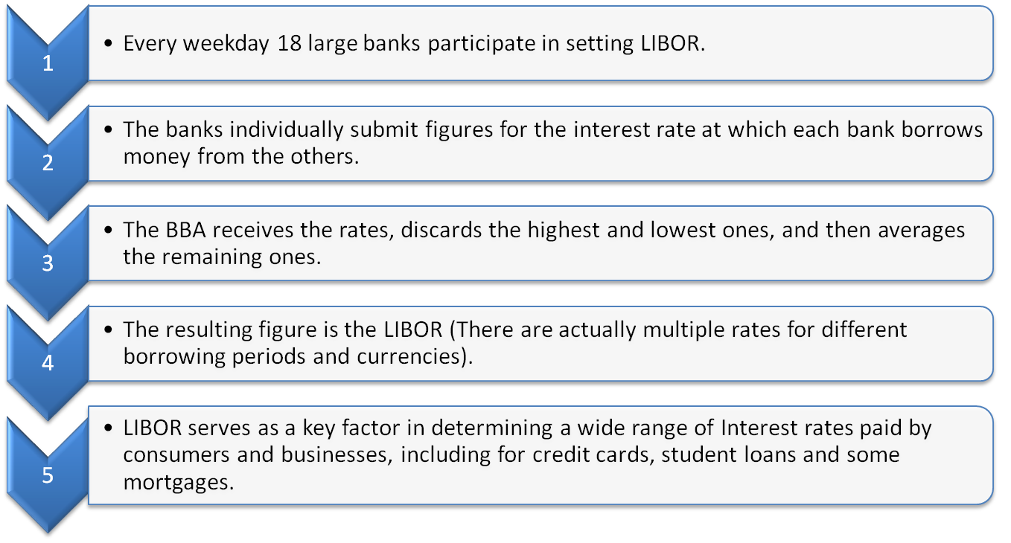
LIBOR

Slide 8
Why do we need LIBOR?

Slide 9
LIBOR
LIBOR was created in the 1980s as banks called for a reliable source to set interest rates for derivatives.
The first LIBOR rate was announced in 1986 for three currencies: the U.S. dollar, the British sterling and the Japanese Yen.
LIBOR is viewed as the most important benchmark in the world for short-term interest rates.

Slide 10
LIBOR
On the professional financial markets LIBOR is used as the base rate for a large number of financial products such as futures, options and swaps.
Banks also use the LIBOR interest rates as the base rate when setting the interest rates for loans, savings and mortgages.
It currently serves as a benchmark rate for millions of contracts worth billions of dollars written everyday all over the world.

Slide 11


CURRENT ACCOUNT DEFICIT
LIBOR
Let us see the formula of the Current Account Balance (CAB)
CAB = X - M + NI + NCT
X = Exports of goods and services
M = Imports of goods and services
NI = Net income abroad [Salaries paid or received, credit / debit of income from FII & FDI etc. ]
NCT = Net current transfers [Workers' Remittances (unilateral), Donations, Aids & Grants, Official, Assistance and Pensions etc]
Let’s consider an example:

Slide 12
LIBOR
Suppose an Indian Company ABC wants to borrow money from the international market.
The lender will charge Libor plus X%, depending on the risk profile of the Company ABC and the country, where X is the risk premium.

Slide 13
LIBOR
Libor also serves some macro purposes.
If Libor is rising continuously, it may be an indication of tight liquidity or rising stress in the financial markets.
The movement of Libor also reflects market expectation on how the central bank will shape its monetary policy.

Slide 14
CURRENT ACCOUNT DEFICIT
LIBOR
Let us see the formula of the Current Account Balance (CAB)
CAB = X - M + NI + NCT
X = Exports of goods and services
M = Imports of goods and services
NI = Net income abroad [Salaries paid or received, credit / debit of income from FII & FDI etc. ]
NCT = Net current transfers [Workers' Remittances (unilateral), Donations, Aids & Grants, Official, Assistance and Pensions etc]
Hope you have understood the concept of LIBOR.

Slide 15
Please give us
your feedback at
professor@tataamc.com

Slide 16
DISCLAIMER
The views expressed in this lesson are for information purposes only and do not construe to be any investment, legal or taxation advice. The lesson is a conceptual representation and may not include several nuances that are associated and vital. The purpose of this lesson is to clarify the basics of the concept so that readers at large can relate and thereby take more interest in the product / concept. In a nutshell, Professor Simply Simple lessons should be seen from the perspective of it being a primer on financial concepts. The contents are topical in nature and held true at the time of creation of the lesson. This is not indicative of future market trends, nor is Tata Asset Management Ltd. attempting to predict the same. Reprinting any part of this material will be at your own risk. Tata Asset Management Ltd. will not be liable for the consequences of such action.
Mutual Fund investments are subject to market risks, read all scheme related documents carefully.

